Slide 1


Slide 2

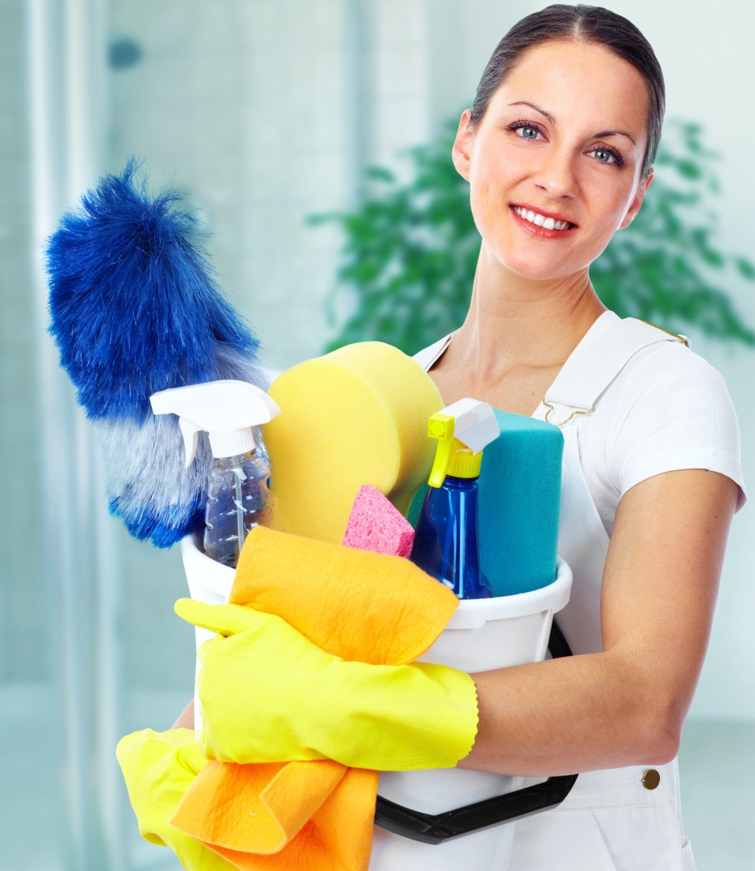
Home Care Category
Hyvest comes from the core words Hygiene and Vestige
  HYGENIUS SOLUTIONS from VESTIGE
Home Hygiene promotes good health and overall wellness for your entire family

Slide 3
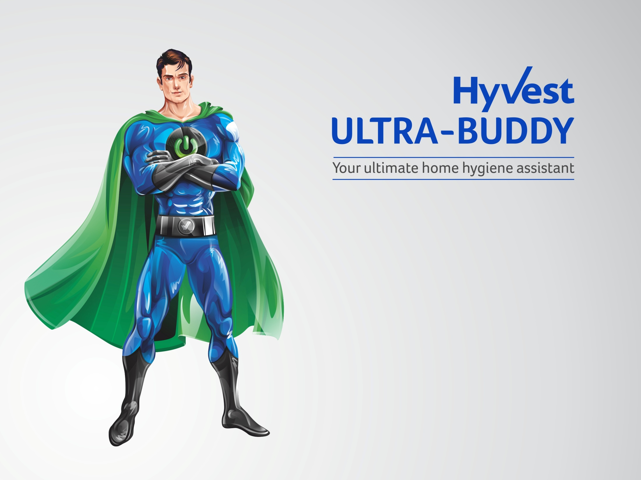
Your home hygiene assistant helps you to provide continuous protection of your loved ones against everyday illnesses.
Germs enter our homes, through people (who may have an infection or are carriers of germs), contaminated food, domestic animals, and sometimes through water or via air.
Good hygiene plays an important part in reducing the burden of infectious diseases in our homes and also prevents them from spreading.

Slide 4
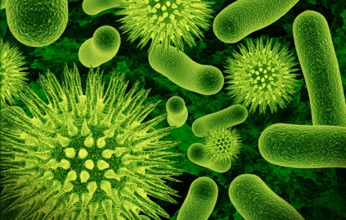
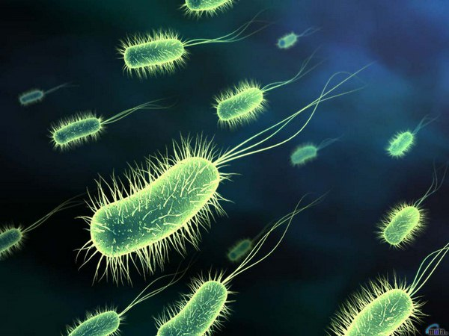
Home Hygiene
Germs can be found everywhere
They can survive on hard surfaces such as floors, doorknobs, handrails etc. for about 24 hours
On soft surfaces such as fabric furniture and beddings, they can survive for 20 – 30 minutes
If the germs aren't allowed into the home, it is easier to protect your family
A clean home would prevent illness before it begins
It would also prevent the spread of disease if practiced on a day to day basis

Slide 5
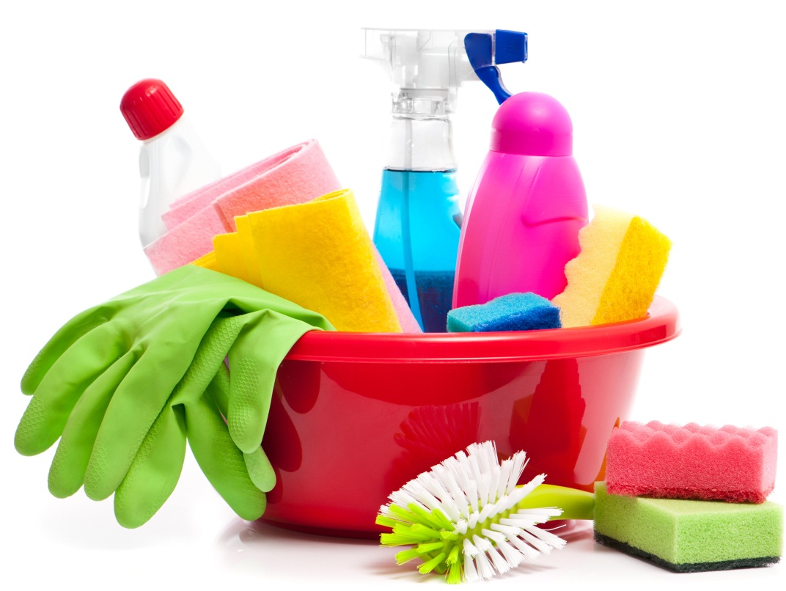
Daily Protection
Maintaining cleanliness at home is not just a “do it and forget it” activity
  It should be in the daily to-do list of every household for healthy living
What to do to keeps germs at bay –
  Clean the dust
  Keep flies away
  Remove garbage everyday
  Keep the bathroom clean and dry
  Allow sunlight into the rooms
  Ventilate the rooms
  Keep kitchen clean and hygienic at all times

Slide 6
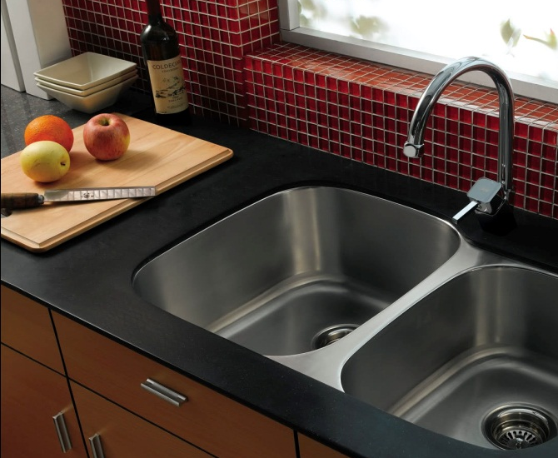
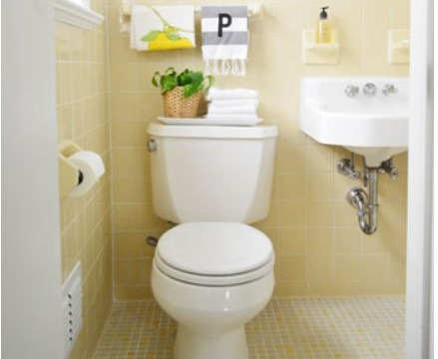
Dirtiest places in your House
KITCHEN
  Kitchen is the favourite ground for germs to grow
  The items that require frequent cleaning in the kitchen:
BATHROOM
  It’s no surprise that the place where you scrub dirt and grim off your body holds a lot of germs
  Due to moisture build up, it is the perfect place for germs growth
  Spots that need special attention:
Dishwashing sponge/scrub | Cutting board
Countertops | Refrigerator
Kitchen sink | Kitchen towel
Shower tub | Floor
Drains | Towels
Taps | Toothbrushes

Slide 7
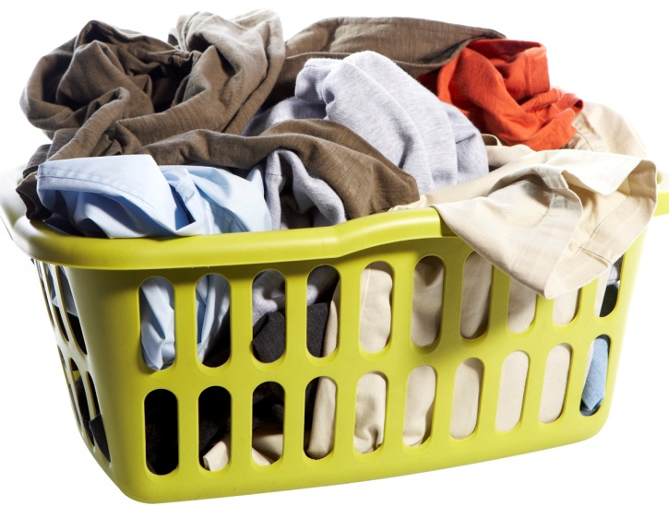
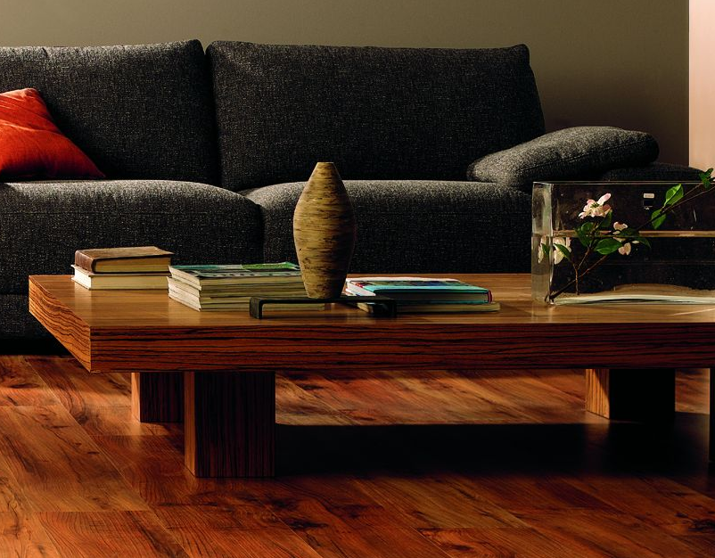
Dirtiest places in your House
LAUNDRY AREA
  Dirty clothes left in the laundry bucket attract a lot of germs due to sweat, food stains, dirt and grime that feed the germs
  Wet laundry left in a machine can cause germs to flourish
LIVING ROOM
  Remote controls, keyboards, phones, and tablets are often shared by everyone in the house
  These surfaces also contribute to bacteria growth and proliferation
  A carpet can hold up to eight times its weight in dirt, dust and mites

Slide 8
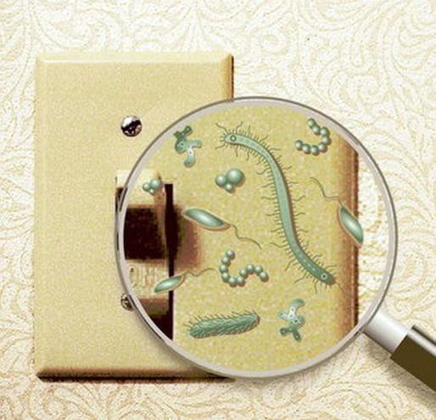
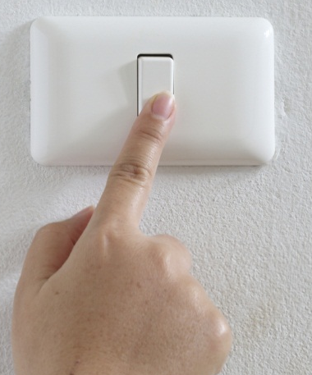
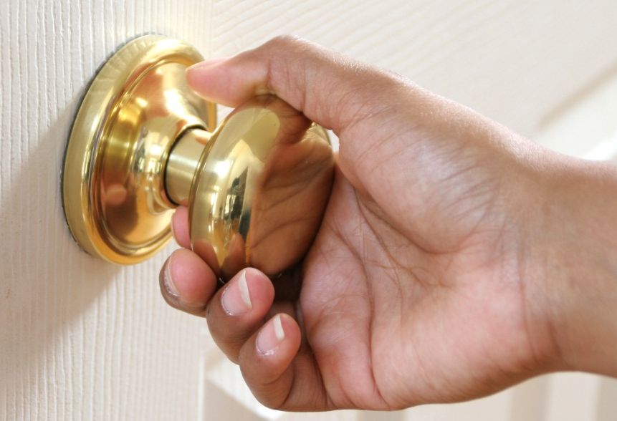
Dirtiest places in your House
KNOBS, HANDLES, AND SWITCHES
  Handles, knobs, light switches are obvious places for germs
  Many studies have shown bacterial and virus growth on:
    Bathroom light switches
    Refrigerator handles
    Door Knobs
    Stove knobs
    Microwave handles
  Clean these spots once a week with sanitizing solution

Slide 9
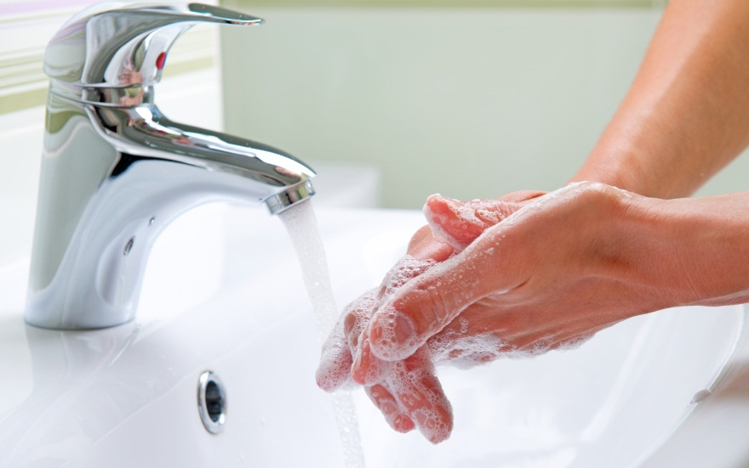
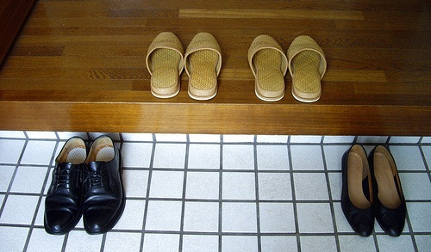
Practicing Good Habits
One way of minimizing germs from spreading is keeping things clean
Clean the dirtiest places in your home daily for healthy living
Wash your hands often with a good antibacterial hand wash to ward of germs and avoid illness
Keep hand sanitizers handy if soap is not available
Take your shoes off before walking into the house

Slide 10

Introducing

Slide 11
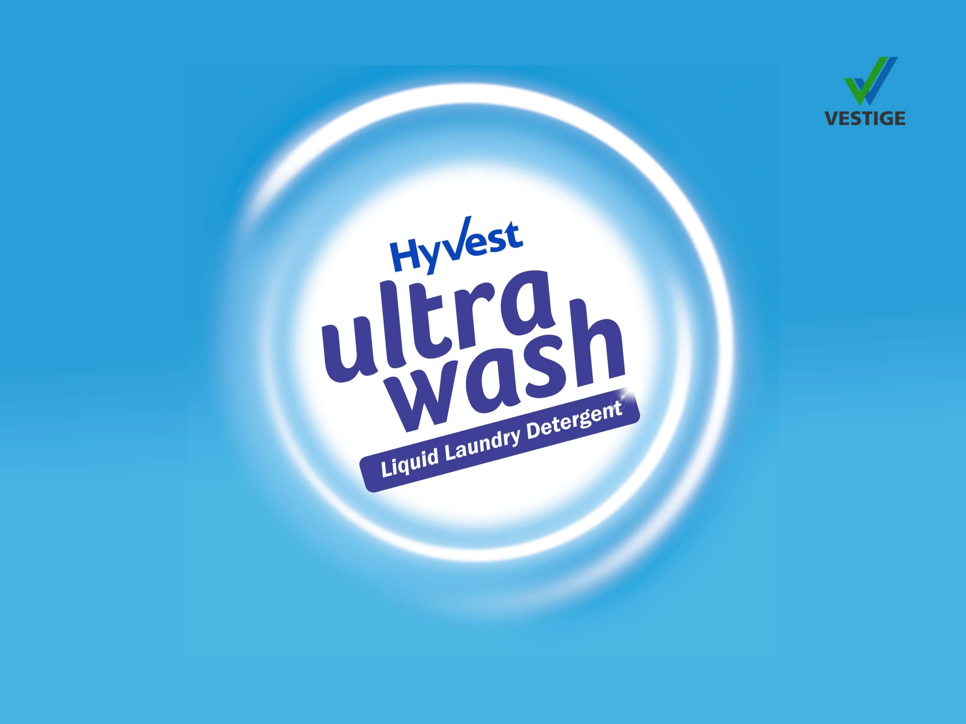

Slide 12
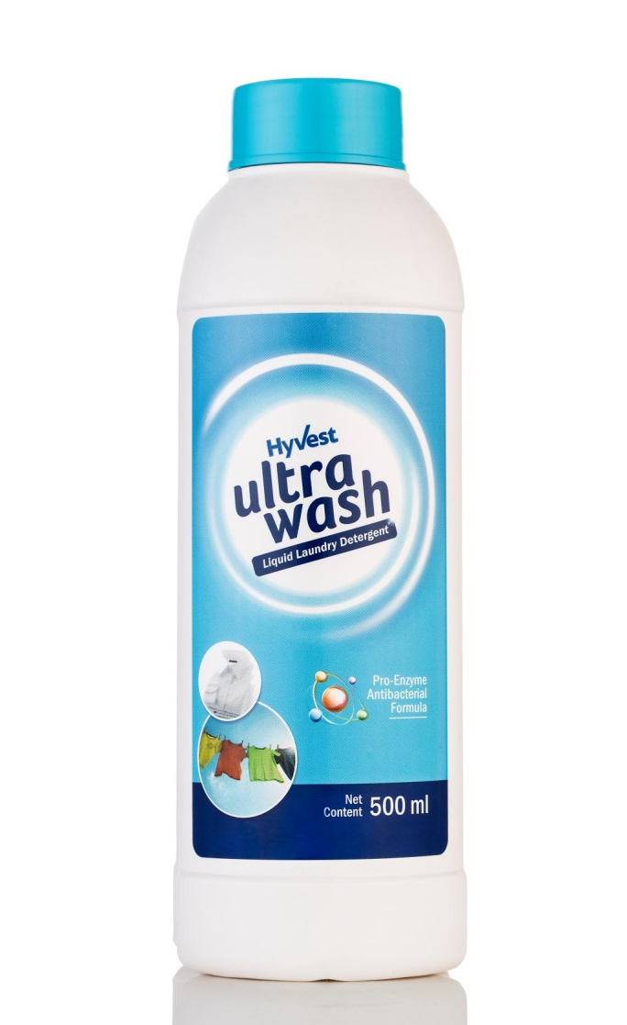
Ultrawash – Liquid Laundry Detergent
Concentrated antibacterial formula with active enzyme technology that is tough on stains and gentle on clothes and hands
Superior cleaning properties effectively removes dirt, grime and unpleasant odour from all types of clothes
Protects and leaves the fabric soft and shining like new
Protects the coloured clothes and brightens up the white clothes
Requires less water for washing compared to popular detergent powders and liquids
  Enriched with antifoaming agents
Enriched with antibacterial Neem extract
Effective for both machine and hand wash

Slide 13
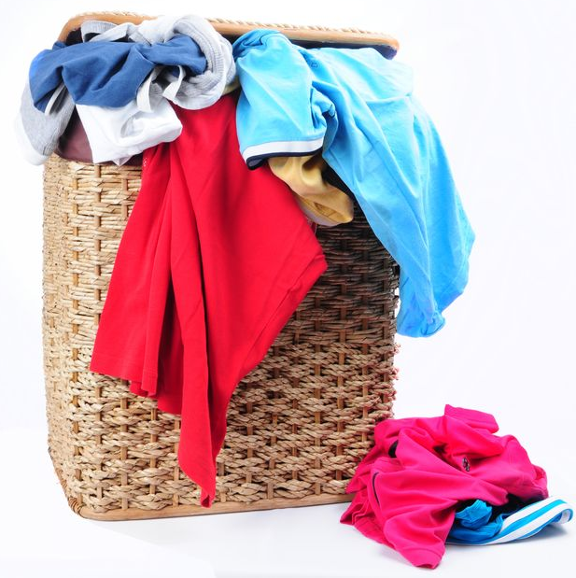
Ultrawash – Liquid Laundry Detergent
USE ON:
All types of clothes including
  Cottons
  Synthetics
  Chiffons
  Georgette
  Jeans
  Sheets
  Quilts
  Baby Clothes etc.
*Not suitable for woolens and silk

Slide 14
Ultrawash – Liquid Laundry Detergent
Application and Cost per use:
Application | Amount | Cost per Use | No. of Uses per bottle
Bucket wash | ½ capful (5 ml) in half bucket (7 L) of water | Rs. 3.45* | 100 Half bucket washes
Machine wash | Regular / Medium Load: 1 capful (10 ml) | Rs. 6.90* | Washes 50 Regular Loads
 | Full / Dirty Load: 2 capful (20 ml) | Rs. 13.80* | Washes 25 Full / Dirty Loads
*cost as per MRP

Slide 15

Ultrawash – Liquid Laundry Detergent
MRP Rs. 345.00
DP Rs. 300.00
BV 180
PV 11.05

Slide 16
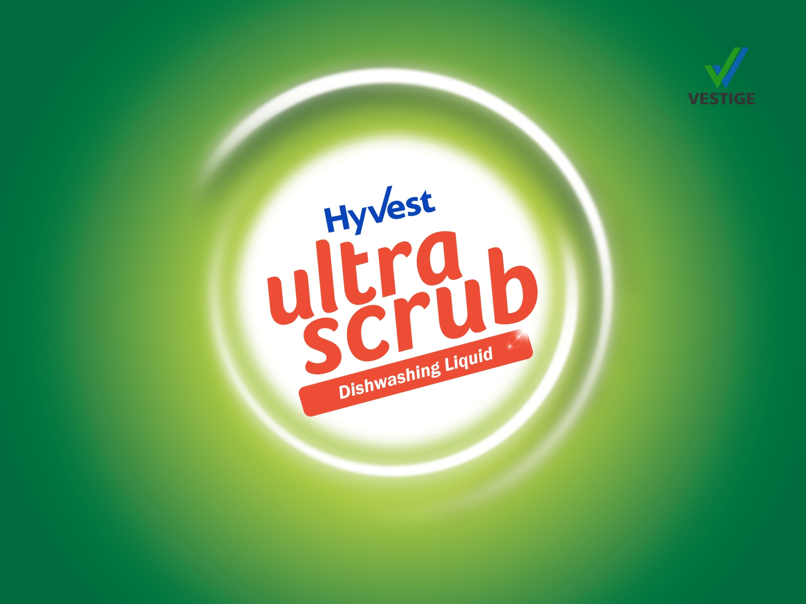

Slide 17
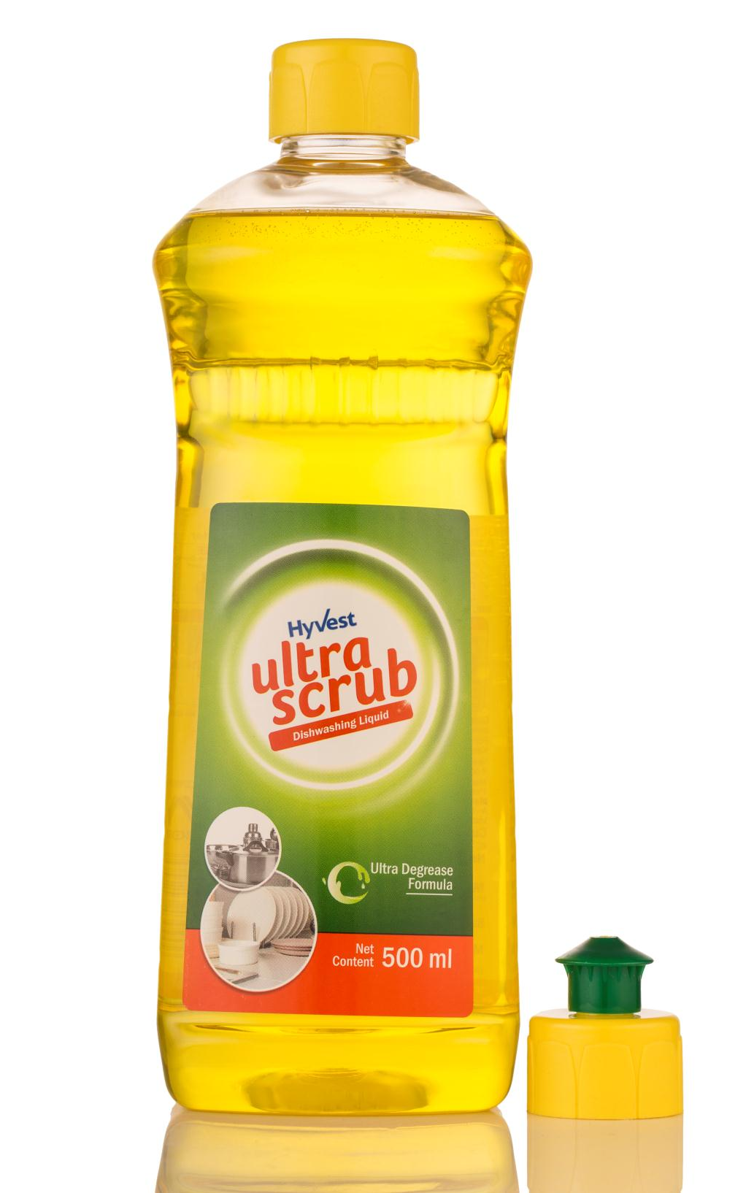
Ultrascrub – Dishwashing Liquid
Concentrated formula for cleaning dishes and utensils
Possesses superior oil and grease removal properties
Gentle on hands
Easily and effectively removes stubborn grease from iron and steel utensils leaving them shining like new
High degreasing strength with power of lemons
Cuts through toughest grease and oily residue
Removes food smell
Leaves utensils sparkling clean

Slide 18
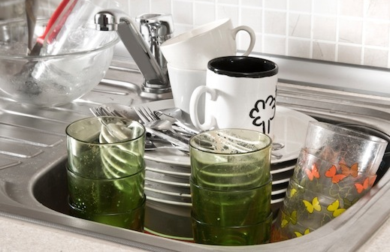
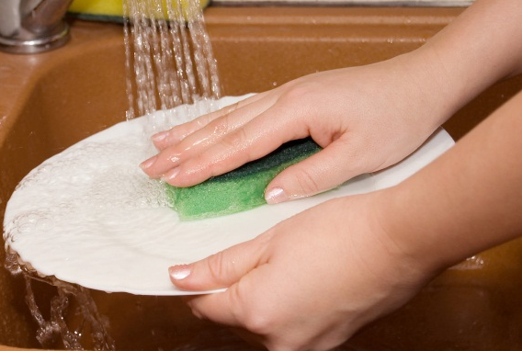
Ultrascrub – Dishwashing Liquid
USE ON:
All types of utensils:
  Stainless steel
  Aluminium
  Iron
  Non-stick cookware
  Glass ware
  Bone china
  Melamine
  Ceramic crockery etc.
FOR REGULAR USE:
  Mix few drops of concentrate in a bowl of water, use on utensils with scrubber pad or sponge
FOR TOUGH STAINS:
  Take one drop of concentrate directly on the scrubber
  Use on utensil with water to scrub off tough stains easily

Slide 19
Ultrascrub – Dishwashing Liquid
Application and Cost per use:
Application | Amount | Cost per Use | No. of Uses per bottle
Regular use: A sink full of Utensils | 1 spoon (5 ml) Ultrascrub in a bowl (100 ml) of water | Rs. 1.85* | 100 sink full of Utensils
Tough Stains | 1 drop (0.5 ml) on scrubber pad | Rs. 0.19* | 1000 drops
*cost as per MRP

Slide 20
Ultrascrub – Dishwashing Liquid
MRP Rs. 185.00
DP Rs. 160.00
BV 96
PV 6.0

Slide 21

DEMONSTRATIONS

Slide 22
Ultrawash – Demo
Take a jar half filled with water
Put a drop of Ultrawash in the jar
Close the lid of the jar and shake vigorously
You will see very less foam formed in the jar*
Ultrawash is designed to form less foam but that does not make it less effective on stains or dirt
Because of this property of Ultrawash, it uses less water for the entire washing and rinsing cycle
*compared to popular detergents

Slide 23
Ultrascrub – Demo
Dip a spoon in oil / margarine / butter
Take out the spoon and remove extra oil or margarine using your fingertips
Put a drop of Ultrascrub in half a glass of water and dip the oily spoon into the glass
Stir the spoon vigorously several times in the glass as if mixing sugar
Remove the spoon from water – the oil / butter will be all gone and the spoon will be sparkling clean with no residue
Ultrascrub Dishwashing Liquid has high degreasing strength that requires very less or no scrubbing

Slide 24
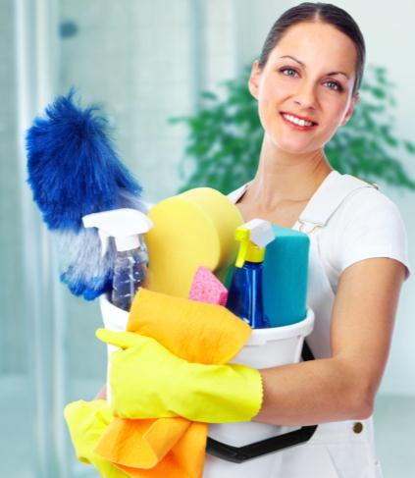
Home Care Category
Hyvest comes from the core words Hygiene and Vestige
  HYGENIUS SOLUTIONS from VESTIGE
Home Hygiene promotes good health and overall wellness for your entire family

Slide 25
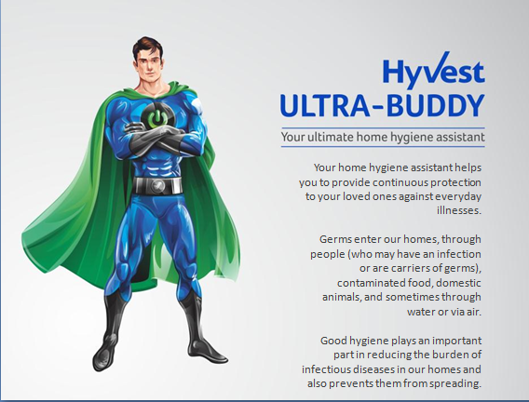
Your home hygiene assistant helps you to provide continuous protection to your loved ones against everyday illnesses.
Germs enter our homes, through people (who may have an infection or are carriers of germs), contaminated food, domestic animals, and sometimes through water or via air.
Good hygiene plays an important part in reducing the burden of infectious diseases in our homes and also prevents them from spreading.

Slide 26


Home Hygiene
Germs can be found everywhere
They can survive on hard surfaces such as floors, doorknobs, handrails etc. for about 24 hours
On soft surfaces such as fabric furniture and beddings, they can survive for 20 – 30 minutes
If the germs aren't allowed into the home, it is easier to protect your family
A clean home would prevent illness before it begins
It would also prevent the spread of germs if proper hygienic practices are adopted

Slide 27
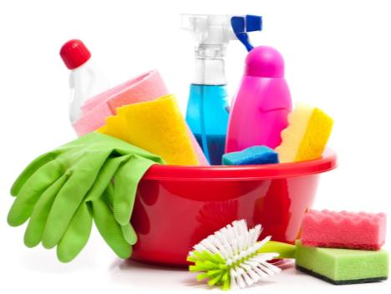
Daily Protection
Maintaining cleanliness at home is not just a “do it and forget it” activity
  It should be in the daily to-do list of every household for healthy living
What to do to keep germs at bay –
  Clean the dust
  Keep flies away
  Remove garbage everyday
  Keep the bathroom clean and dry
  Allow sunlight into the rooms
  Ventilate the rooms
  Keep the kitchen clean and hygienic at all times

Slide 28
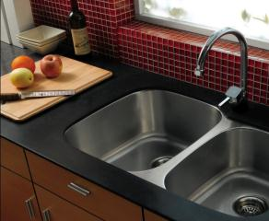
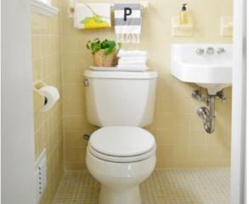
Dirtiest Places in Your House
KITCHEN
  Kitchen is the favourite ground for germs to grow
  The items that require frequent cleaning in the kitchen:
BATHROOM
  It’s no surprise that the place where you scrub dirt and grime off your body holds a lot of germs
  Due to moisture build up, it’s the perfect place for germs to grow
  Spots that need special attention:
Dishwashing sponge/scrub | Cutting board
Countertops | Refrigerator
Kitchen sink | Kitchen towel
Shower tub | Floor
Drains | Towels
Taps | Toothbrushes

Slide 29
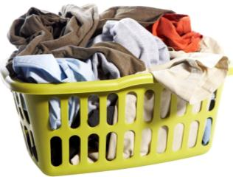
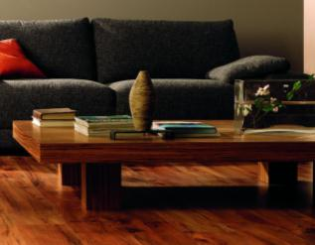
Dirtiest Places in Your House
LAUNDRY AREA
  Dirty clothes left in the laundry bucket attract a lot of germs due to sweat, food stains, dirt and grime that feed the germs
  Wet laundry left in a machine can cause germs to flourish
LIVING ROOM
  Remote controls, keyboards, phones, and tablets are often shared by everyone in the house
  These surfaces also contribute to bacteria growth and proliferation
  A carpet can hold dirt, dust and mites up to eight times its weight

Slide 30
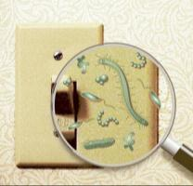
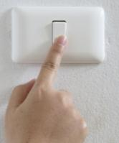
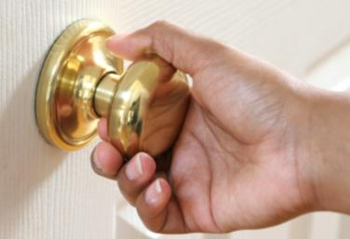
Dirtiest Places in Your House
KNOBS, HANDLES, AND SWITCHES
  Handles, knobs, light switches are obvious places for germs
  Many studies have shown bacterial and virus growth on:
    Bathroom light switches
    Refrigerator handles
    Door Knobs
    Stove knobs
    Microwave handles
  Clean these spots once a week
  Electrical switches must be cleaned with utmost caution

Slide 31
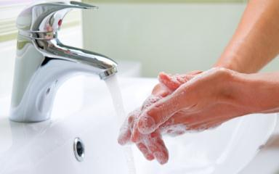
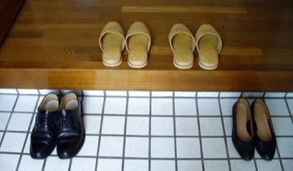
Practicing Good Habits
One way of minimizing germs from spreading is keeping things clean
Clean the dirtiest places in your home daily for healthy living
Wash your hands often with a good antibacterial hand wash to ward of germs and avoid illness
Keep hand sanitizers handy if soap is not available
Take your shoes off before walking into the house

Slide 32
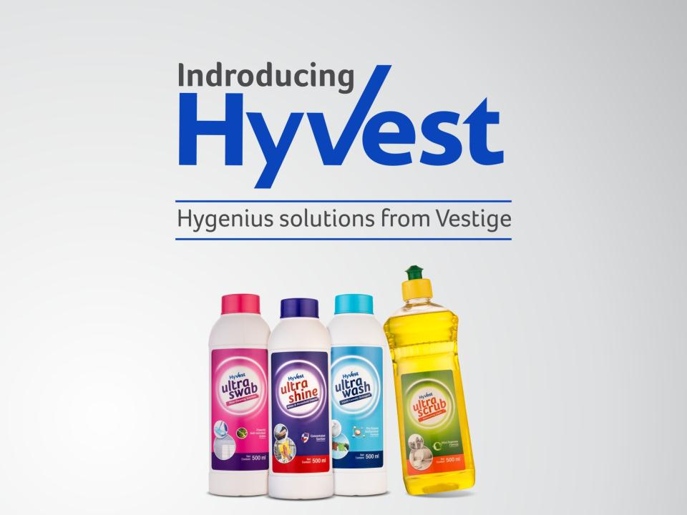

Slide 33
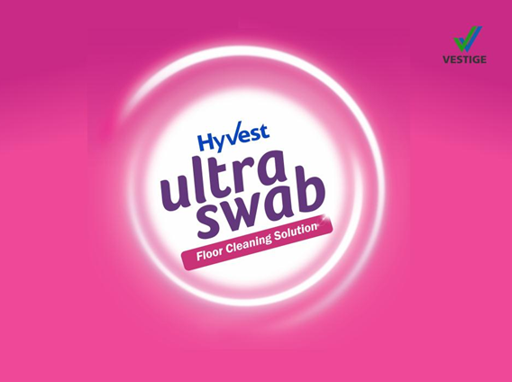

Slide 34
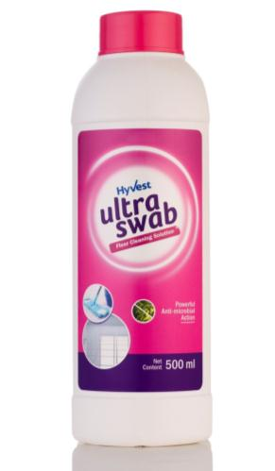
Ultraswab – Floor Cleaning Solution
Concentrated formula for daily cleaning and mopping
It gives total germ protection by killing 99.9% of germs including bacteria, virus and fungus
Effectively removes tough stains, dirt and grime from all kind of household surfaces
Leaves the mopped area refreshingly clean with a long lasting floral fragrance
Contains Benzalkonium Chloride solution that completely disinfects any surface

Slide 35
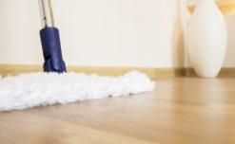
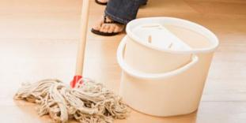
Ultraswab – Floor Cleaning Solution
USE ON:
All types of floors & surfaces:
  Marble
  Mosaic
  Wooden
  Granite
  Ceramic, etc.
  Kitchen countertops
  Tiles
  Bathroom floors etc.
FOR REGULAR USE: Floor Mopping
  Use half capful (10ml) of concentrate in one fourth (1/4) bucket of water (4 L)
  Gently wipe using a mop. No need to rinse.
KITCHEN SURFACE:
  Use undiluted for tough stains, or diluted for regular cleaning
  Use a kitchen towel for best results

Slide 36
Ultraswab – Floor Cleaning Solution
Application and Cost per use:
Application | Amount | Cost per Use | No. of Uses per bottle
Mopping home floors (marble, ceramic, granite, tiles etc.) | 2 spoons (10 ml) or 1/2 cap in 1/4th of bucket (4 L) of water | ₹3.90* | 50 days of cleaning
For Tough Stains | 1 spoon (5 ml) on sponge or kitchen towel | ₹1.95* | 100 spoons
*cost as per MRP

Slide 37
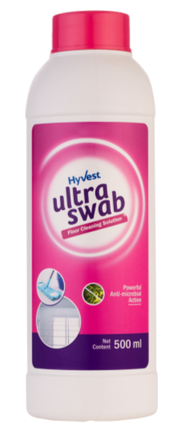
Ultraswab – Floor Cleaning Solution
MRP ₹195.00
DP ₹170.00
BV 102
PV 6.38

Slide 38
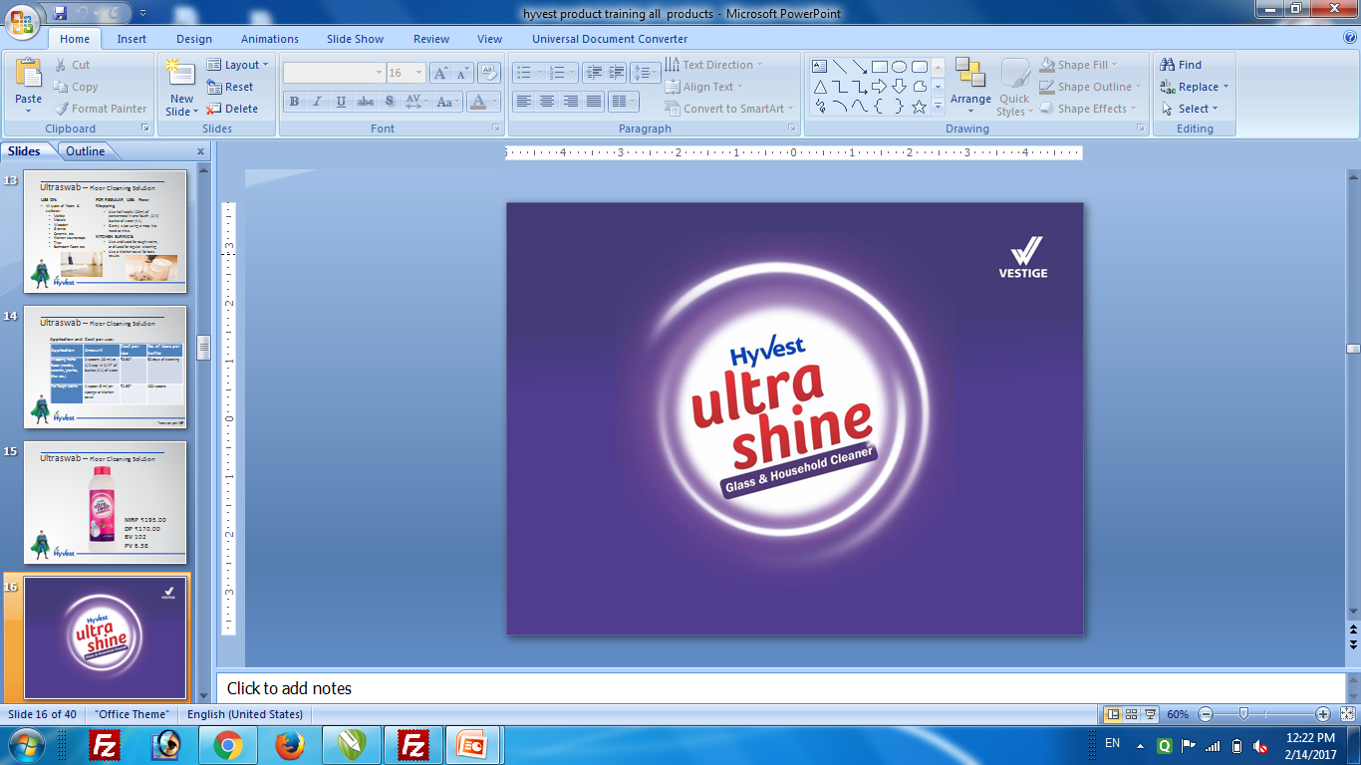

Slide 39
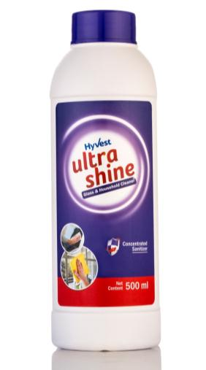
Ultrashine – Glass & Household Cleaner
Concentrated formula that gives powerful cleaning performance
Removes dust, dirt and lint leaving the surface sparkling clean
Effectively removes stains and fingerprints without leaving any harmful oily residues
Enriched with powerful shine promoters for superior performance
Removes static charge from surfaces
Does not contain any toxic volatile substances
Soft on hands
Economical cost per usage at 1:2 dilution ratio with water

Slide 40
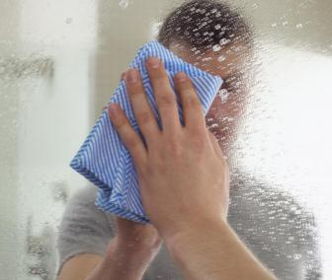
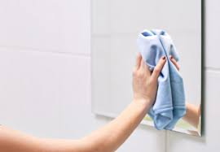
Ultrashine – Glass & Household Cleaner
USE ON:
All types of surfaces:
  Glass
  Mirrors
  Laminated furniture
  LED / LCD TV & screens
  Electronic appliances
  Fridge doors
  Microwave doors
  Kitchen appliances and cabinets etc.
FOR REGULAR USE:
Use by diluting with water at the ratio of 1:2 - one part Ultrashine concentrate with 2 parts of water
Always use the Spray Application bottle for best results
Wipe with a lint-free cloth for best results

Slide 41
Ultrashine – Glass & Household Cleaner
Application and Cost per use:
Application | Amount | Cost per Use | No. of Uses per bottle
Regular Use (at 1:2 dilution with water, one part Ultrashine concentrate with 2 parts of water) | Glass Surface, mirrors, kitchen appliances, fridge doors etc.: 1 ml (approx. 2-3 sprays) | ₹ 0.13* | 3000 sprays* per bottle of concentrate
 | Ceiling fan, computer / TV screens, furniture etc.: 2 ml (approx. 4-6 sprays) | ₹ 0.26*
For best results always use the Spray Application bottle
*cost as per MRP

Slide 42
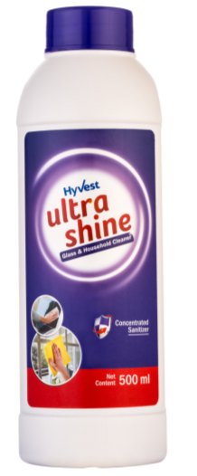
Ultrashine – Glass & Household Cleaner
MRP ₹200.00
DP ₹175.00
BV 105
PV 6.56

Slide 43
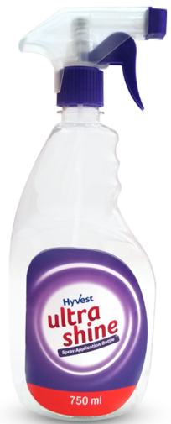
Ultrashine – Glass & Household Cleaner
Use this special Spray Application bottle to mix 250 ml of Ultrashine with 500 ml of water and spray it on the surface that you want to clean.
Shake well before use.
Always use a clean, dry, and lint-free cloth for cleaning
Empty Spray Bottle
MRP ₹28.00
DP ₹28.00
BV 5.6
PV 0.35

Slide 44
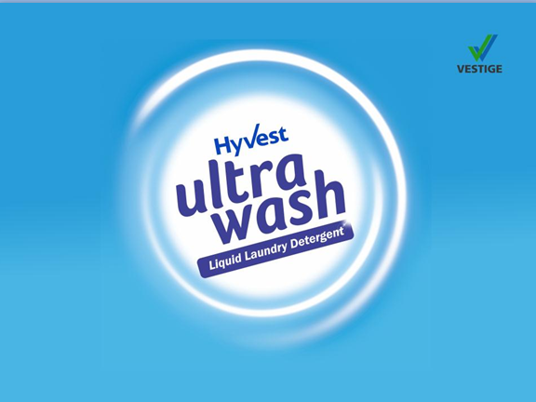

Slide 45
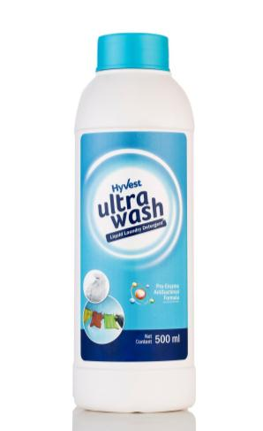
Ultrawash – Liquid Laundry Detergent
Concentrated antibacterial formula with active enzyme technology that is tough on stains and gentle on clothes and hands
Superior cleaning properties effectively removes dirt, grime and unpleasant odour from all types of clothes
Protects and leaves the fabric soft and shining like new
Protects the coloured clothes and brightens up the white clothes
Requires less water for washing compared to popular detergent powders and liquids
  Enriched with antifoaming agents
Enriched with antibacterial Neem extract
Effective for both machine and hand wash

Slide 46
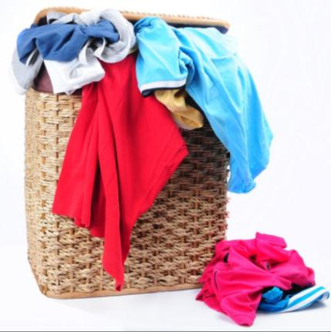
Ultrawash – Liquid Laundry Detergent
USE ON:
All types of clothes including
  Cottons
  Synthetics
  Chiffons
  Georgette
  Jeans
  Sheets
  Quilts
  Baby Clothes etc.
*Not suitable for woolens and silk

Slide 47
Ultrawash – Liquid Laundry Detergent
Application and Cost per use:
Application | Amount | Cost per Use | No. of Uses per bottle
Bucket wash | 1 spoon (5 ml) in half bucket of water 4-5 Clothes | ₹3.45* | 100 Half bucket washes
Machine wash | Regular / Medium Load (10-12 clothes): 2 spoons (10 ml) or ½ capful | ₹6.90* | Washes 50 Regular Loads
 | Full / Dirty Load (20-25 clothes): 4 spoons (20 ml) or 1 capful | ₹13.80* | Washes 25 Full / Dirty Loads
*cost as per MRP

Slide 48
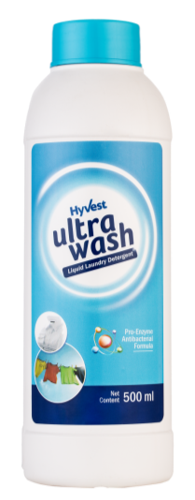
Ultrawash – Liquid Laundry Detergent
MRP ₹345.00
DP ₹300.00
BV 180
PV 11.25

Slide 49
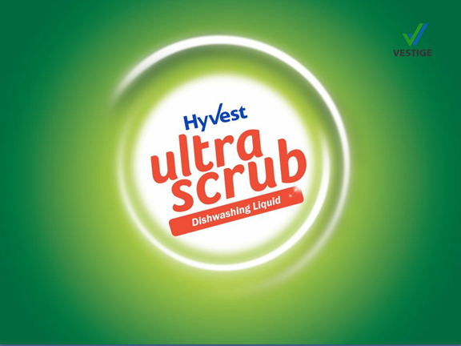

Slide 50

Ultrascrub – Dishwashing Liquid
Concentrated formula for cleaning dishes and utensils
Possesses superior oil and grease removal properties
Gentle on hands
Easily and effectively removes stubborn grease from ceramic and steel utensils leaving them shining like new
High degreasing strength with power of lemons
Cuts through toughest grease and oily residue
Removes food smell
Leaves utensils sparkling clean

Slide 51


Ultrascrub – Dishwashing Liquid
USE ON:
All types of utensils:
  Stainless steel
  Aluminium
  Non-stick cookware
  Glass ware
  Bone china
  Melamine
  Ceramic crockery etc.
FOR REGULAR USE:
  Mix few drops of concentrate in a bowl of water, use on utensils with scrubber pad or sponge
FOR TOUGH STAINS:
  Take one drop of concentrate directly on the scrubber
  Use on utensil with water to scrub off tough stains easily

Slide 52
Ultrascrub – Dishwashing Liquid
Application and Cost per use:
Application | Amount | Cost per Use | No. of Uses per bottle
Regular use: A sink full of Utensils | 1 spoon (5 ml) Ultrascrub in a bowl (100 ml) of water | ₹1.85* | 100 sink full of Utensils
Tough Stains | 1 drop on scrubber pad | ₹0.19* | 1000 drops
*cost as per MRP

Slide 53

Ultrascrub – Dishwashing Liquid
MRP ₹185.00
DP ₹160.00
BV 96
PV 6.0

Slide 54

DEMONSTRATIONS

Slide 55
Ultrashine – Demo
Take a hand held mirror
Apply black shoe polish with your finger tips on the upper part of the mirror
Rub a creamy lipstick on the lower part of the mirror
Spray diluted Ultrashine using the Spray Application Bottle on the mirror (just one spray is enough)
Using a face tissue or lint-free cloth gently wipe away the shoe polish and lipstick from the mirror
The mirror will shine like new!

Slide 56


Ultrashine – Glass & Household Cleaner
Concentrated Formula
With powerful Shine Promoters
Removes stains, fingerprints etc.
Removes dust and lint
No oily residue
Removes static charge

Slide 57


Ultraswab – Floor Cleaning Solution
Concentrated Formula
Kills 99.9% germs
Gives total germ protection
Removes tough stains
Cuts through dirt and grime
Refreshing and lasting fragrance

Slide 58
Ultrascrub – Demo
Dip a spoon in oil or butter
Take out the spoon and remove any extra oil or butter using your fingertips
Put a drop of Ultrascrub in half a glass of water and dip the same spoon into the glass
Stir the spoon vigorously several times in the glass as if mixing sugar
Remove the spoon from water – the oil / butter will be all gone and the spoon will be sparkling clean with no residue
Ultrascrub Dishwashing Liquid has high degreasing strength that requires very less or no scrubbing

Slide 59


Ultrascrub – Dishwashing Liquid
Concentrated Formula
Ultra Degreasing strength
Removes stubborn grease easily
Removes oily residue
Gentle on hands
With power of lemons

Slide 60
Ultrawash – Demo
Take a jar half filled with water
Put a drop of Ultrawash in the jar
Close the lid of the jar and shake vigorously
You will see very less foam formed in the jar*
Ultrawash is designed to form less foam but that does not make it less effective on stains or dirt
Because of this property of Ultrawash, it uses less water for the entire washing and rinsing cycle
*compared to popular detergents

Slide 61


Ultrawash – Liquid Laundry Detergent
Concentrated Formula
With Enzyme Technology
Antibacterial with Neem
Tough on stains, soft on hands
Requires less water
Protects colourful clothes

Slide 62
THANK YOU

